Slide 1
How to Deal With Nonnormal Data in Process Improvement Projects
Presenter: John Noguera, P. Eng., Co-founder and CTO, SigmaXL, Inc.

Slide 2
AGENDA
SigmaXL Tools to Detect Nonnormal Data
  Graphical Tools
  Normality Tests
Things To Consider When Dealing With Nonnormal Data
  Do I have outliers or inherently nonnormal data?
  How do I deal with a bimodal distribution?
  How do I deal with nonnormality due to measurement discrimination (“chunky” data)
When do I need to worry about nonnormal data? Is the Central Limit Theorem working for me?
Guidelines on sample size for Central Limit Theorem to work (for mild, moderate and severe skewness)
SigmaXL Tools to Deal With Nonnormal Data
  Transformations and Distribution Fitting
  Nonparametric Tests
Presentation: 50 Minutes; Q&A: 10 minutes

Slide 3
SigmaXL Tools to Detect Nonnormal Data
Graphical Tools:
  Histogram (detect skewness, bimodal distribution, outliers, truncation)
  Boxplot (detect outliers)
  Control Chart/Run Chart (detect trends, outliers)
  Normal Probability Plot (separate outliers and inherently nonnormal data)
Normality Tests:
  Anderson Darling (p < .05 indicates nonnormal data)
  Skewness & Kurtosis (p < .05 indicates skewness or kurtosis)

Slide 4
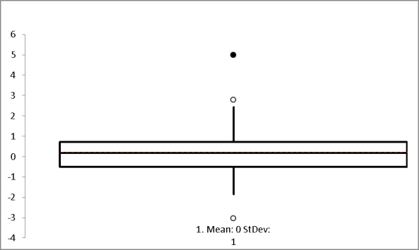
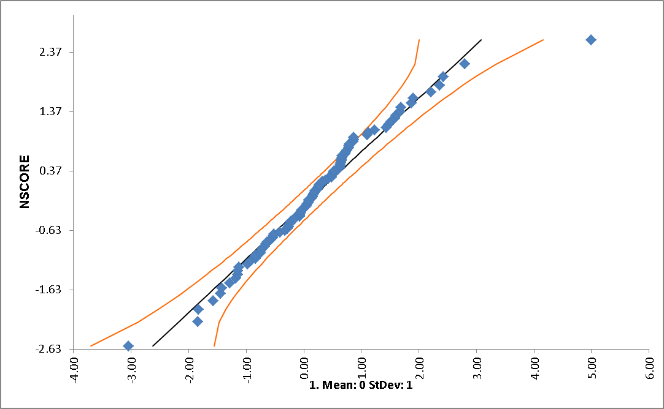


Things To Consider When Dealing With Nonnormal Data
Do I have outliers or inherently nonnormal data?
  Use the graphical tools and process knowledge.
  Do not simply delete outliers! Deal with the special causes.
  Do test for normality with outlier removed.
  Correct known data entry errors (ok to delete).
With Outlier:
With Outlier Removed :
Outlier

Slide 5
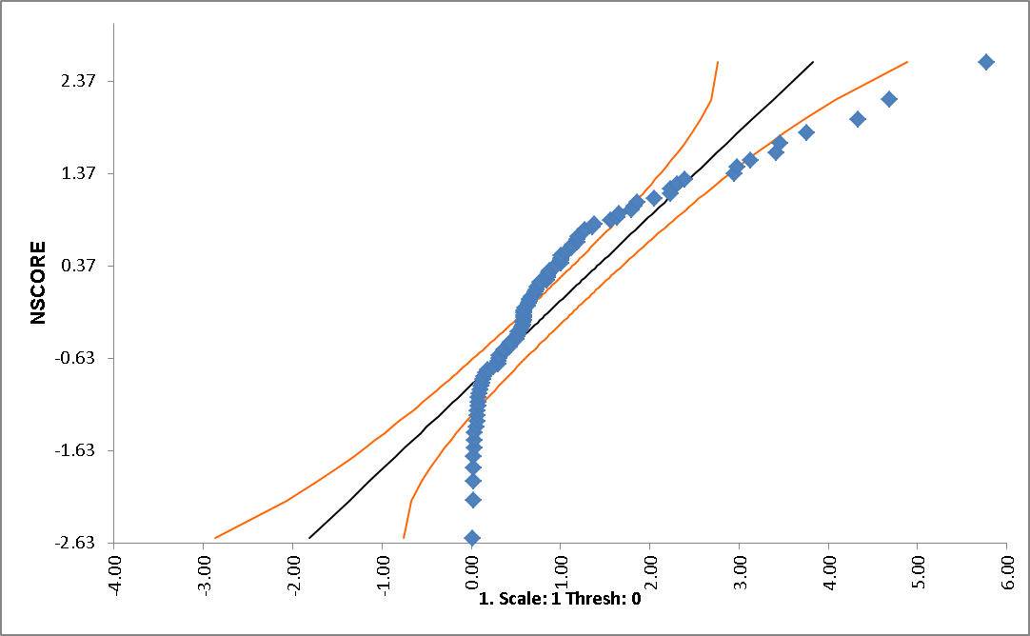
Things To Consider When Dealing With Nonnormal Data
Do I have outliers or inherently nonnormal data?
Normal Probability Plot for Inherently Nonnormal Data

Slide 6
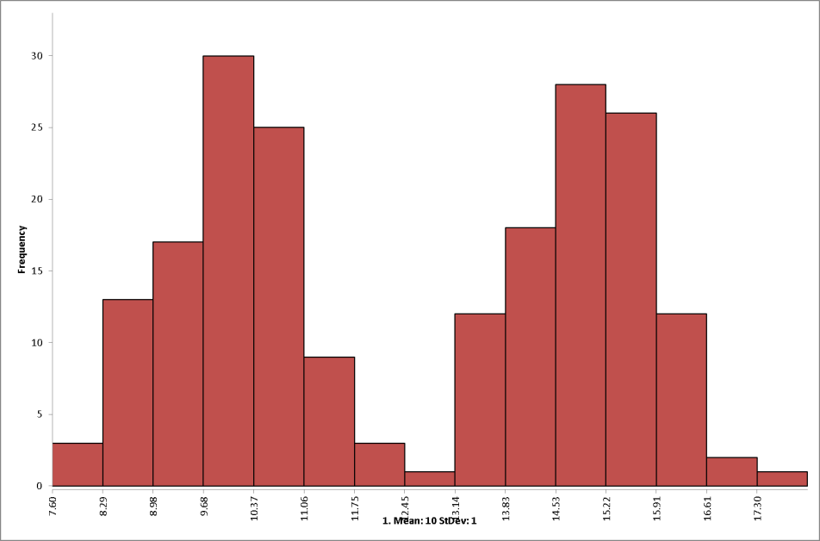
Things To Consider When Dealing With Nonnormal Data
How do I deal with a bimodal distribution?
  Identify with Histogram (bimodal distribution)
  Stratify for analysis (use group category variable). Confirm with 2 Sample t-test
  Control the “X” factor

Slide 7
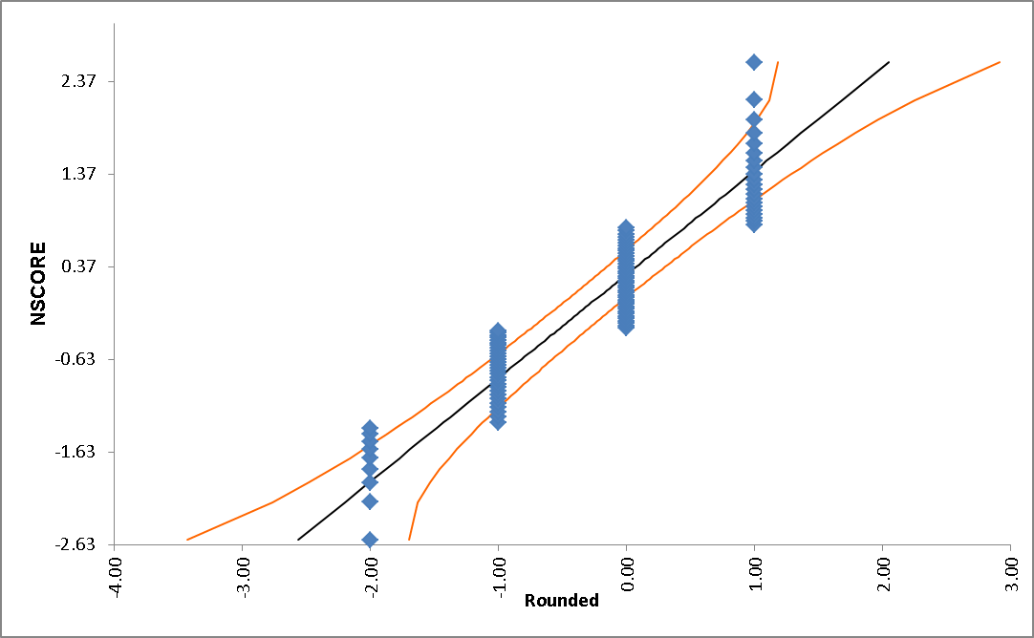
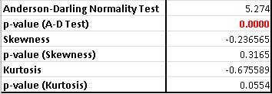
Things To Consider When Dealing With Nonnormal Data
How do I deal with nonnormality due to measurement discrimination (“chunky” data)
  Identify with Normal Probability Plot
  Improve measurement system discrimination

Slide 8
When do I need to worry about Nonnormal data (i.e., is the Central Limit Theorem working for me)?
Central Limit Theorem applies in hypothesis testing of averages (1 Sample t, 2 Sample t, ANOVA).
If you have individual observations (rather than subgroups), n=1, then the central limit theorem does not apply.
If you are performing a process capability study or creating an individuals control chart, normality is assumed. Nonnormal data will produce incorrect results (poor estimates of capability, false alarms). Apply transformations or distribution fitting.

Slide 9
Guidelines on sample size for central limit theorem to work (for mild, moderate and severe skewness)
Rule of Thumb: Minimum Sample Size = 50* (Skewness)²
^{Mild Skewness = 0.5 (use n=30)}
Moderate Skewness = 1.0 (use n=50)
Strong Skewness = 2.0 (use n=200)
This is relevant for hypothesis testing on the mean or use of x-bar control charts
If n is too small, and a larger sample size is not practical, use nonparametric tools

Slide 10
SigmaXL Tools to Deal With Nonnormal Data
Transformations and Distribution Fitting
  Capability Combination Report (Individuals Nonnormal)
  Distribution Fitting
  Individuals Nonnormal Control Chart
Box-Cox Transformation (includes an automatic threshold option so that data with negative values can be transformed)
Johnson Transformation

Slide 11
SigmaXL Tools to Deal With Nonnormal Data
Distributions supported:
    Half-Normal
    Lognormal (2 & 3 parameter)
    Exponential (1 & 2 parameter)
    Weibull (2 & 3 parameter)
    Beta (2 & 4 parameter)
    Gamma (2 & 3 parameter)
    Logistic
    Loglogistic (2 & 3 parameter)
    Largest Extreme Value
    Smallest Extreme Value
Automatic Best Fit based on AD p-value

Slide 12
SigmaXL Tools to Deal With Nonnormal Data
Nonparametric Tests:
  1 Sample Sign and 1 Sample Wilcoxon (nonparametric equivalent to a 1 Sample t)
  2 Sample Mann-Whitney (nonparametric equivalent to a 2 Sample t)
  Kruskal-Wallis and Mood’s Median Test (nonparametric equivalent to ANOVA)
  Runs Test (used with Run Chart)
  Spearman Rank correlation (nonparametric equivalent to Pearson correlation)

Slide 13
SigmaXL Tools to Deal With Nonnormal Data
Nonparametric tests make fewer assumptions about the distribution of the data compared to parametric tests like the t-Test. Nonparametric tests do not rely on the estimation of parameters such as the mean or the standard deviation, rather use median and ranks. They are sometimes called distribution-free tests.
Note that nonparametric tests are less powerful than normal based tests to detect a real process change.

